Slide 1

CNCF Cloud Native Meetup Madrid - OCTOBER 2023
GitOps at Real Scale with Fleet Project
Juan Herrera Utande - SUSE

Slide 2
Agenda
Introduction to CI/CD
What is Fleet (and Rancher)
The architectural challenges of Continuous Delivery
Fleet design principles
Other features summary
Some project numbers

Slide 3





What is Continuous Delivery? Learn the jargon first
Continuous Integration (CI) is a software development approach where developers regularly merge their code in a central repository. Automated validations, builds, and tests are then triggered helping to surface any integration problem early in the process
Continuous Delivery/Deployment (CD) complements CI to cover the automated deployment of all those software artifacts produced by the CI process in a set of target environments
DevOps is a much broader practice that integrates the development best practices as defined on CI/CD to also cover the operational aspect of application management and life cycle. The name comes from the union of the Development and Operations worlds.
GitOps is an operations framework built around DevOps best practices that use Git as the source of truth for deployments and environment configuration management (e.g., Kubernetes), ensuring system state alignment and providing an audit trail with rollback capability
CD tools
CI tools

Slide 4
What is Fleet?
Fleet is a Continuous Delivery/Deployment open-source tool.
It’s a Kubernetes-native application so it’s API first and relies on CRDs and Operators.
Created in 2020 by Rancher to offer CD capabilities more closely aligned to the Rancher Kubernetes management philosophy (Kubernetes at scale)
Used internally by Rancher Management Application to manage downstream clusters, also available to end users to implement their own CD strategy
It can work together and coexist with other CI/CD tools like ArgoCD and Flux
Relevant links:
Website: https://fleet.rancher.io/
Git: https://github.com/rancher/fleet

Slide 5



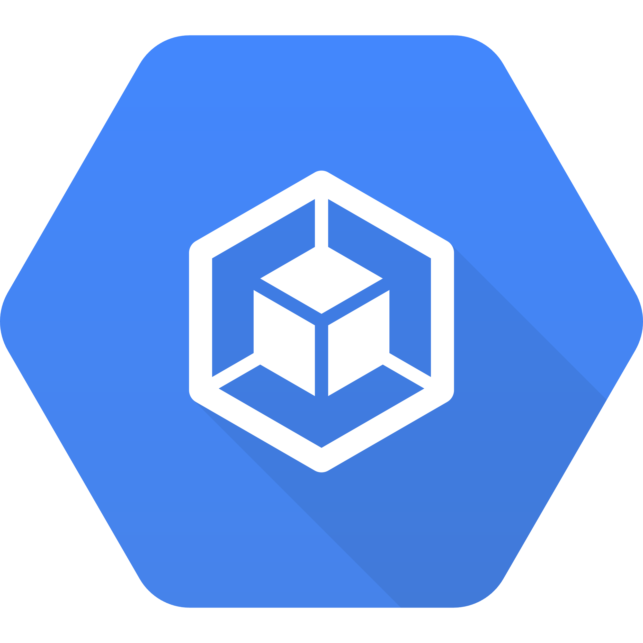






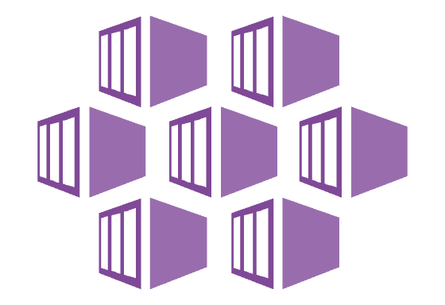
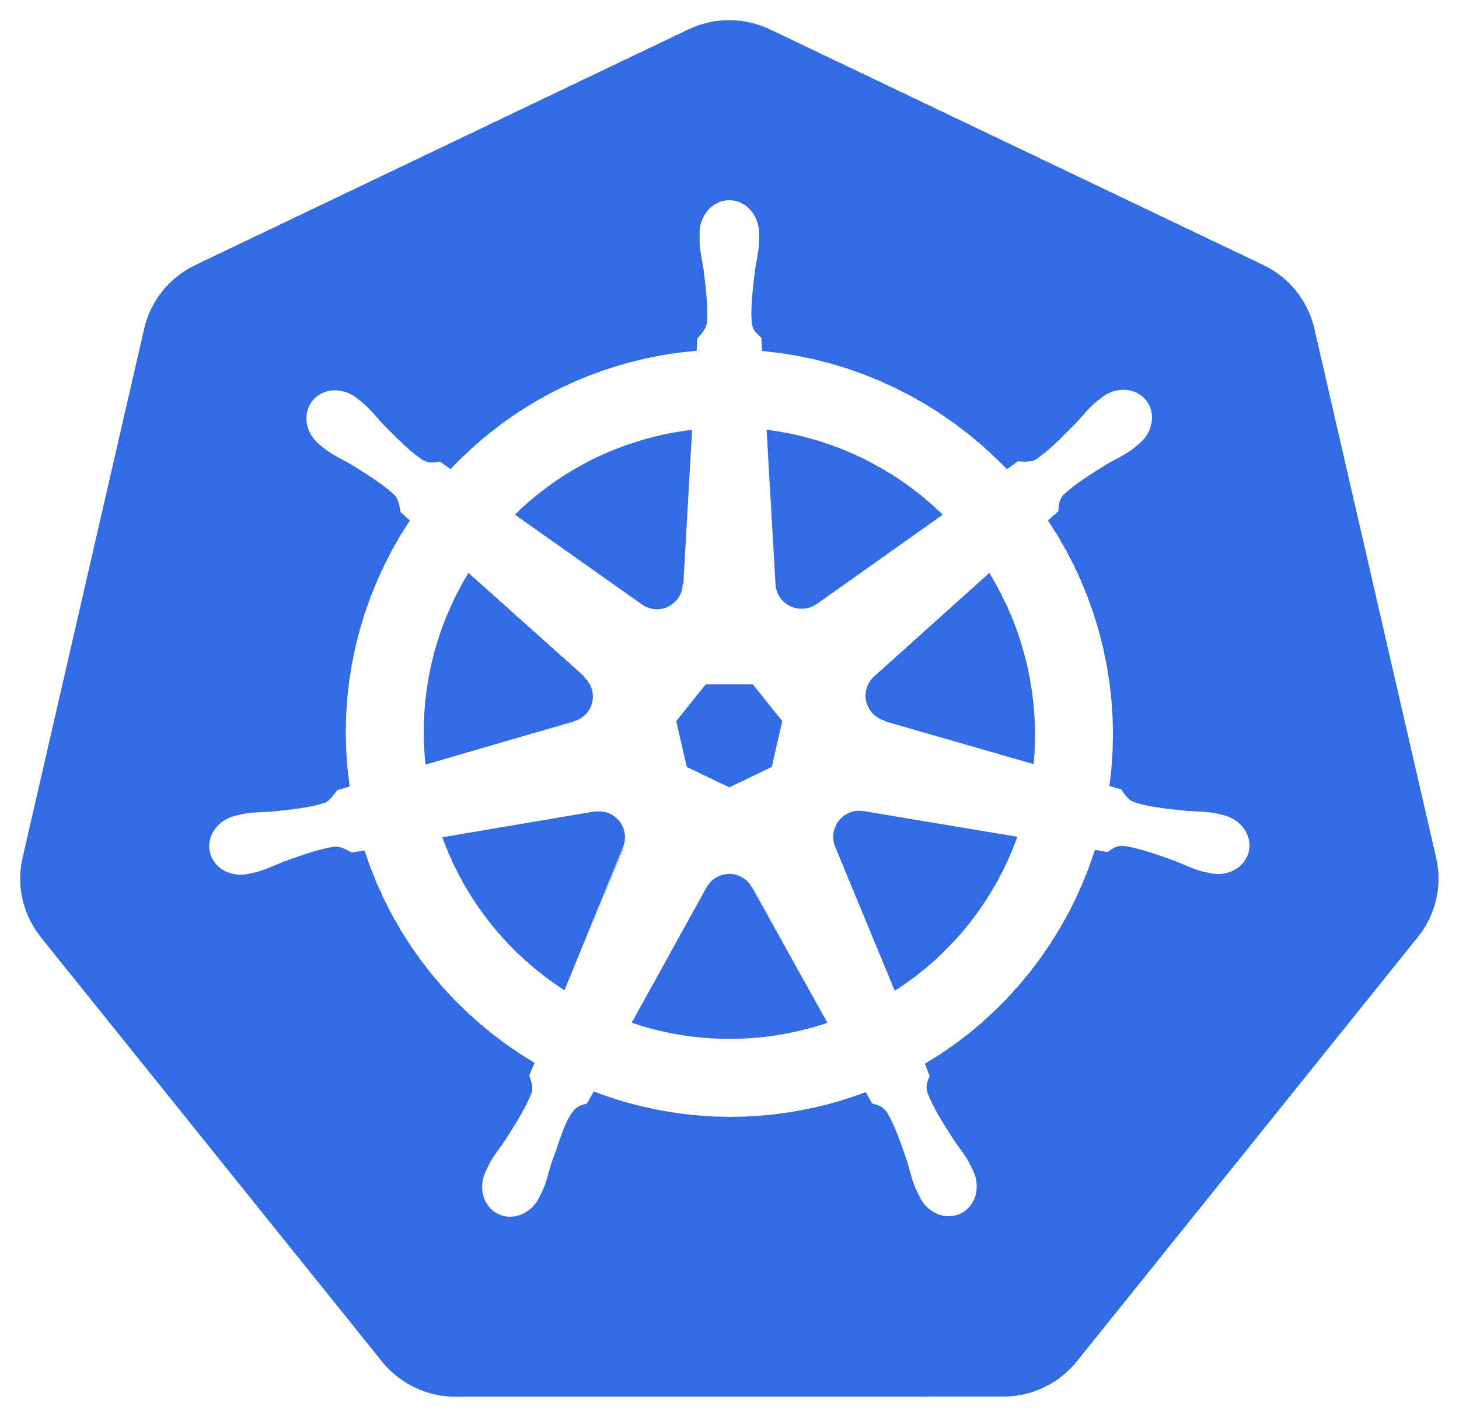
What is Rancher?
Kubernetes security
Kubernetes security
Red Hat ACS
At scale!
Multi-cluster management
Multi-cluster management & Platform services
Red Hat ACM
Additional Platform Services
Cloud Native
Storage
OpenShift Container Platform
Basic Platform Services & Kubernetes & OS
User defined CD (optional)
OpenShift
Data
Foundation
Cloud Native
Storage
Kubernetes
Kubernetes
RKE, RKE2, K3s
GKE
OpenShift Kubernetes Engine
EKS
Any OS
AKS
Any K8s …

Slide 6
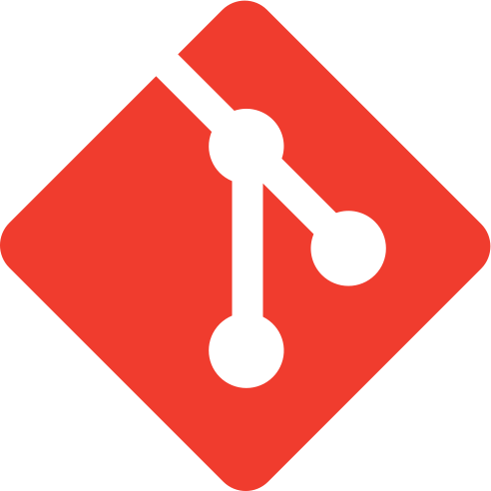
ArgoCD (& Flux) architectural challenges
ArgoCD is great!
Some limitations:
Security: ArgoCD need direct visibility to the K8s API of target clusters
Scale:
Push model implies scaling challenges (usually just few tens of clusters)
Complex topologies or complex operational models needed to use it at scale
Argo
Pull
Push/sync
Notes:
ArgoCD is great. Easy UI and rich set of features have helped the growth of Kubernetes CD strategies
single instance, per cluster instances, and a compromise between the two through grouping or tools that aggregate reporting and control

Slide 7
Fleet design principles
Keep it simple: dumb pipe model
”Unlimited” scale
Pull vs Push
Advanced targeting
Bandwidth optimization
How to allow secure and flexible topologies

Slide 8
How to scale better with Fleet: main pillars
Dumb pipe
A
Network traffic optimization
Downstream clusters PULL Git repo status and definitions (bundles) from the main Fleet Controller Cluster or Rancher Management Cluster
Advanced targeting and variables: how to target hundreds of repos to thousands of Kubernetes clusters
B

Slide 9
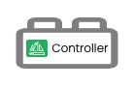

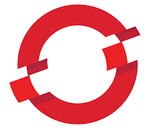

Secure and flexible topologies
Central location
Public cloud
Direct traffic
The management layer doesn’t need direct access to managed clusters. No exposed endpoints.
Simplified FW and networking.
Expiring registration tokens and restricted Service Account (only access to list bundles, and check bundle and cluster status)
Drop incoming
Tunneled traffic
+
+
Edge location
Drop incoming
Direct traffic used for payload: get Bundles, check for repo changes, ….
Tunneled traffic just used to check cluster/bundle state, …
Supports non persistent links and air gapped scenarios*
Store
Drop incoming
Notes:
Clusters are registered by optionally expiring cluster registration tokens

Slide 10
Other features summary
Full support for Helm and Kustomize
Git: Multi-repo and multi-branch
Git: Both polling and web-hook modes
Helm: support for dependency resolver
Granularity: Cluster, Cluster Group and Evnironment
Powerful Targeting Semantics
Built-in RBAC*
Store Fleet configuration (fleet.yaml) at managed Git repos
…
Notes:
Storing the fleet.yaml in the managed Git repositories brings several benefits:
Decentralized Configuration: Each repository contains its configuration, making it self-contained. This decentralization allows for better modularization of applications or services, where each module or service can have its deployment configurations without depending on a centralized source.
Versioning and History: By having the fleet.yaml in the Git repository, any changes to the configuration are versioned alongside the application code or Kubernetes manifests. This versioning makes it straightforward to track changes over time, understand the evolution of deployment configurations, and roll back to previous states if necessary.
Atomicity of Changes: When making changes to application code or Kubernetes manifests, developers can also adjust the fleet.yaml in the same commit or pull request. This atomicity ensures that code and its deployment configuration change together, reducing the risk of mismatches or inconsistencies.
Clarity and Transparency: Storing fleet.yaml in the repository ensures that anyone with access to the repo can quickly understand the deployment configuration without needing to refer to an external source. It increases transparency for team members and other stakeholders.
Flexibility for Different Environments: Different branches or forks of the repository can have variations of fleet.yaml, allowing for customized deployments based on environments (e.g., production, staging, development).
Unified CI/CD Workflow: With fleet.yaml in the same repo, CI/CD processes can be streamlined. Any CI tooling or scripts can take both the application manifests and the Fleet configuration into account in a single workflow.
Security: Changes to deployment configurations undergo the same review process as code changes. This review process ensures that any modifications to how applications are deployed are vetted, audited, and approved, providing an added layer of security.

Slide 11
Some real world numbers
Theoretical scale up to 1 million clusters (blame etcd!)
QA works on the 10.000 mark
Some real-world customer using Fleet:
Retail: +1000 K3s managed clusters
Surveillance cameras: 1 single node K3s cluster per camera. Avg. 50 cameras per venue, designed to scale up to 250
Industrial Edge: 120 factories with 2 clusters per factory. ~50 different source repos
Telco: network access platform with 900 locations (1x3 node K3s cluster per location)
Remember: every cluster managed by Rancher uses Fleet underneath …

